Slide 1
“Breadboarding” a Simple FM Transmitter Assembly Instructions
The New Jersey Antique Radio Club’s
Radio Technology Museum
At InfoAge
REV. 0.7.1 – 7 DEC 2016

Slide 2
Your Work Begins Here
Assemble an FM transmitter prototype
Observe its operation.

Slide 3
Inventory the Components Identify the Components and lay them on this sheet.
RESISTORS | CAPACITORS | MISC.
R2 22K Ohms RED-RED-BLACK-RED-BROWN | C1, C7 0.1 microfarad “104” | Q1 Transistor “S9018”
R3 220 Ohms RED-RED-BLACK-BLACK-BROWN | C2 0.01 microfarad “103”
 | C5 10 picorofarad “10”
 | C6 30 picofarad “30”
104
103
10
30

Slide 4
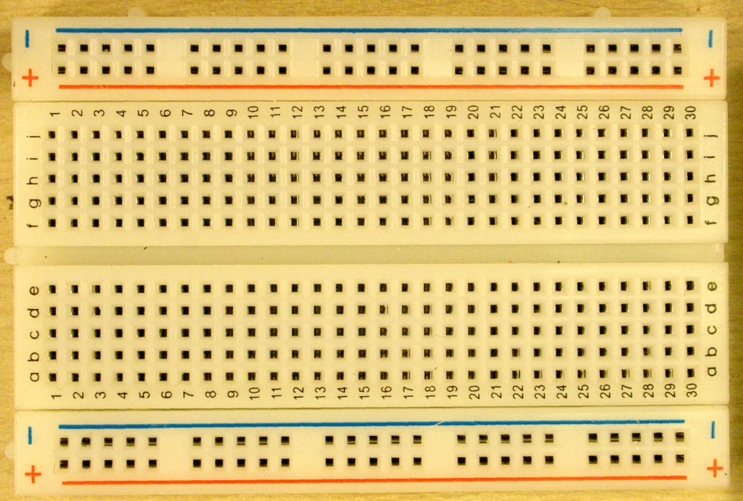
Modern Solder-less Breadboard
B+ BUS
GENERAL
WIRING
B- BUS
Shaded indicates common connections.

Slide 5
The Schematic Diagram

Slide 6
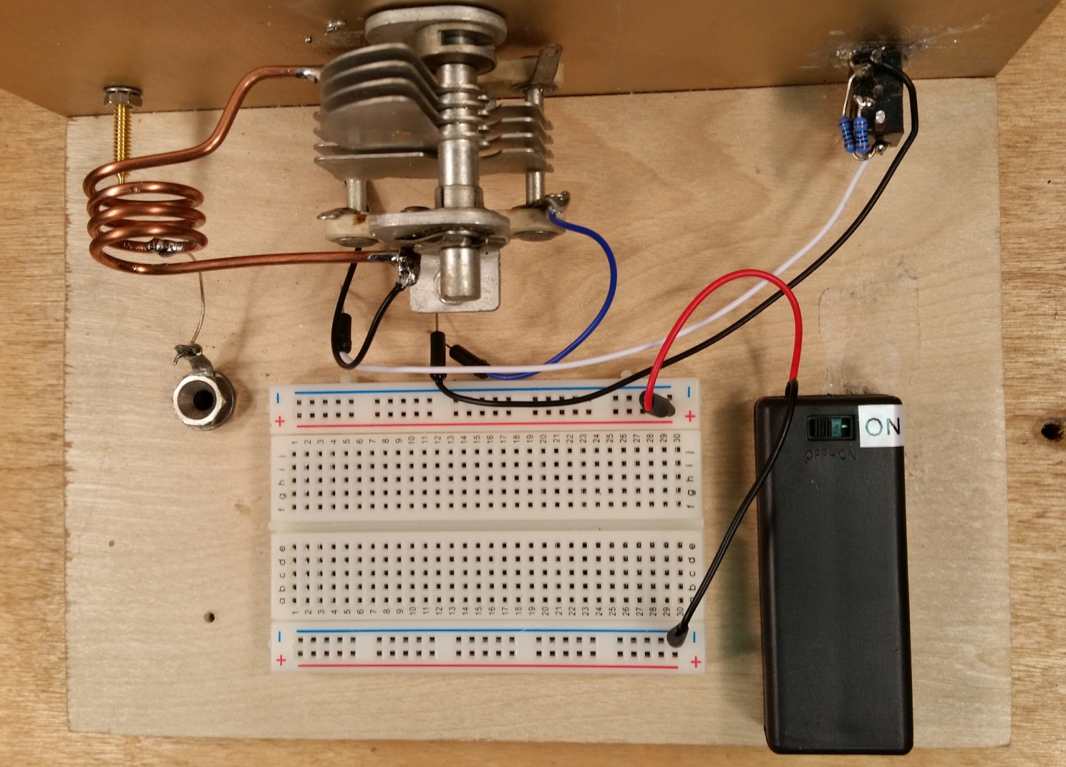
The Setup
L1
C3
Audio-Input Jack
Antenna
Jack
INSURE
POWER SWITCH
IF OFF!
Radio Frequency (RF)
parallel tuned circuit, Li and C3
Battery Case
With Switch
We’ve taken care of some mechanical details for you.

Slide 7
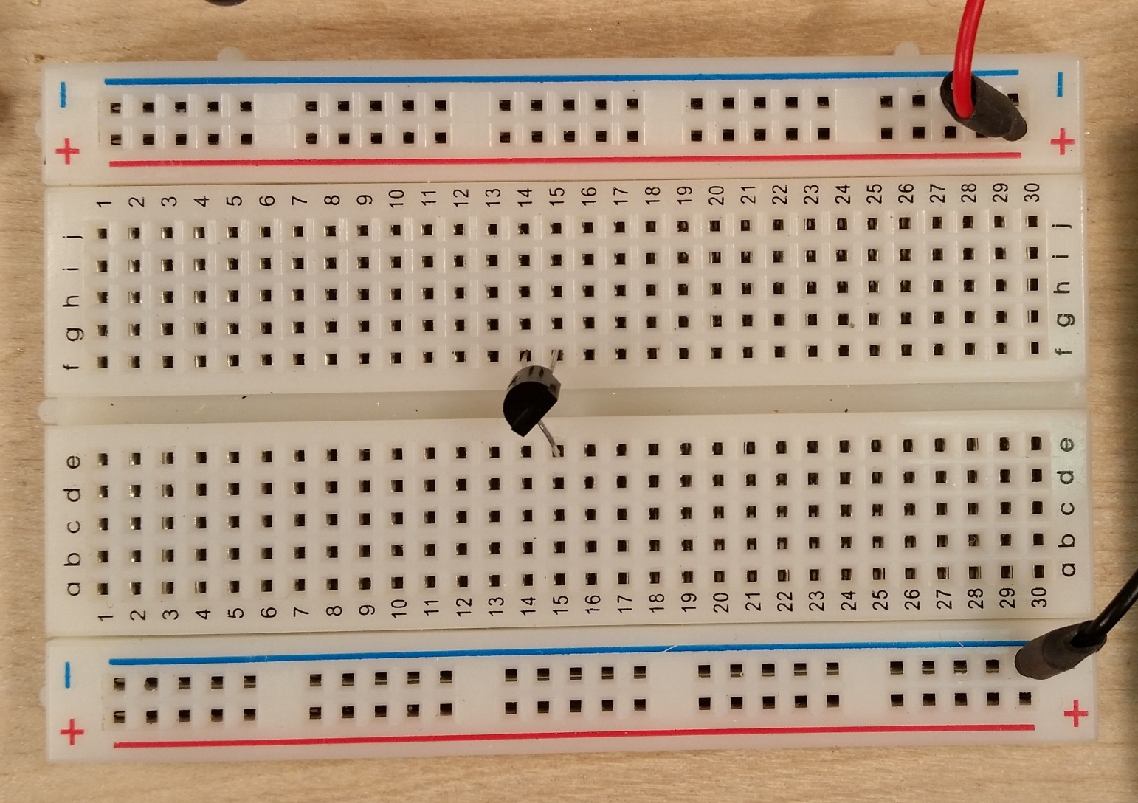
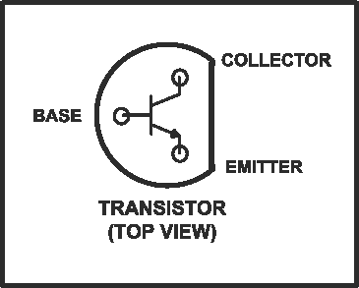
Step 1
BASE
COLLECTOR
EMITTER
Install transistor Q1. Observe pin-out diagram.
(The rest of the circuit will be built around Q1.)

Slide 8
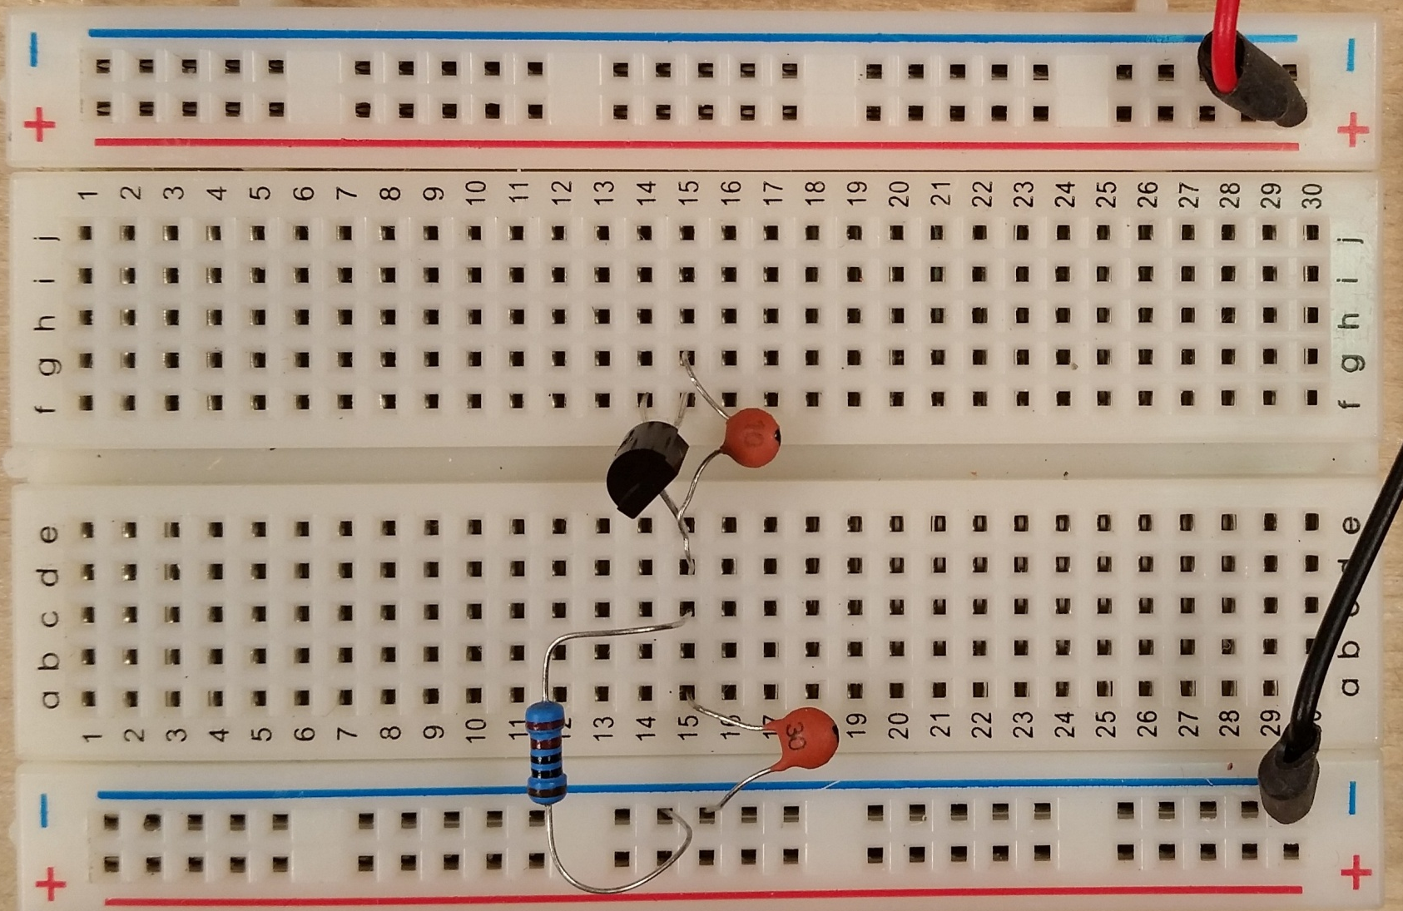
Step 2
BASE
COLLECTOR
EMITTER
Install feedback cap, C5 (10pF “10”), between the collector and emitter of Q1
Install C6 (30 pF “30”) , and R3 (220 Ω - RED RED BLK BRN BRN) in Q1’s emitter circuit..
NOTE: “p” stands for “pico”, or 1x10⁻⁹

Slide 9
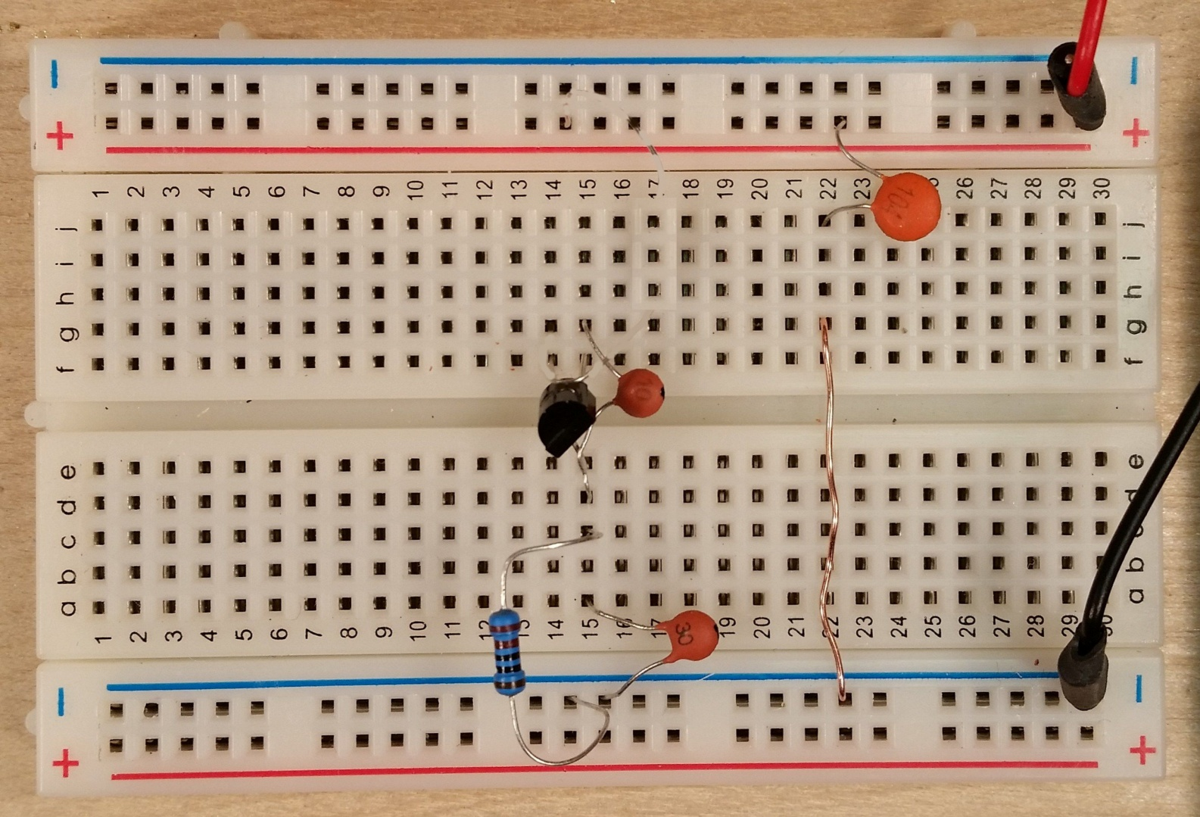
Step 3
Install power-bus bypass cap C7 (0.1 uF “104”) and jumper.

Slide 10
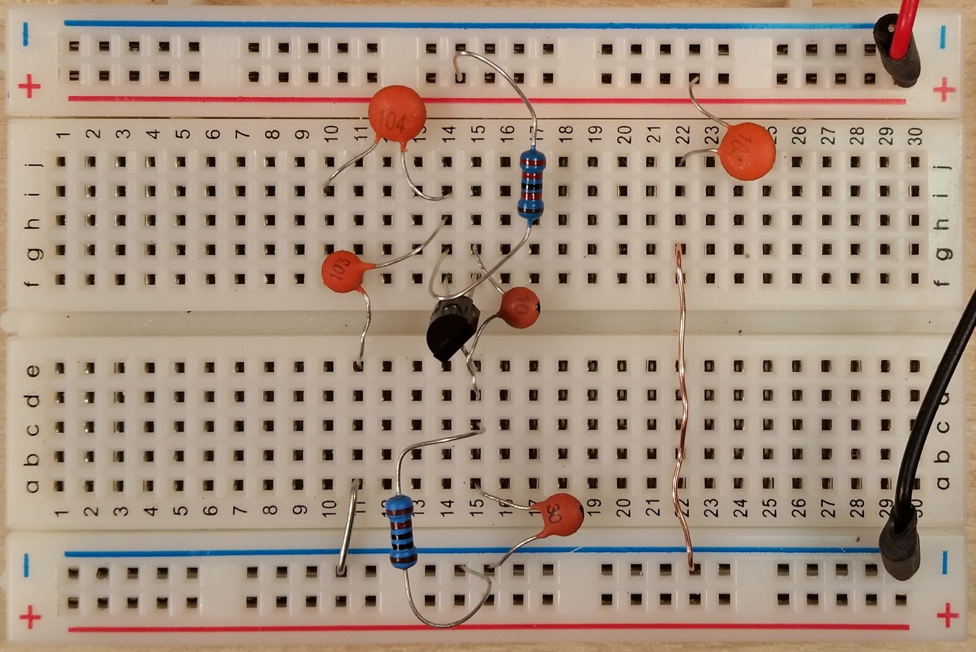
Step 4
BASE
C1
R2
C2
JUMPER TO
GROUND
Install base-circuit components R2 (22 KΩ “RED RED BLK RED BRN”), C1 (0.1 uF “104”),
C2 (0.01 uF “103”), and jumper.

Slide 11
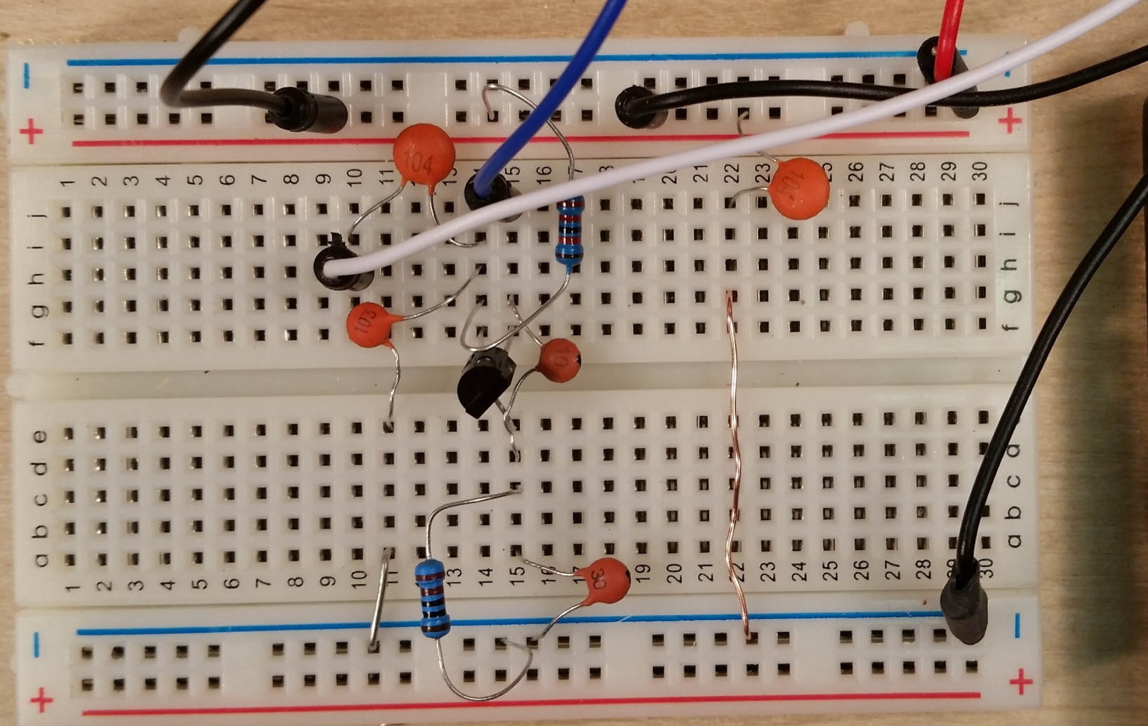
Step 5
TUNED CIRCUIT “HOT”
AUDIO
GROUND
TUNED CIRCUIT GROUND
AUDIO
INPUT
Connect jumpers from tuned circuit as shown.
Connect jumpers from the audio jack as showm.

Slide 12
Step 6
Check connections against the schematic diagram.

Slide 13
Check Out

Slide 14
Check Out
Install antenna rod.
Connect counterpoise wire to the terminal on the front panel.
Connect your mobile device to the audio jack. Play some music.
Turn on the FM receiver.
Tune to an unused frequency.
Indicated by rushing sound. (White Noise)
Place receiver a few feet from the breadboard.
Turn on the FM transmitter
Tune the transmitter (knob on panel) to “quiet” the receiver.
Adjust audio level on the mobile device for minimum distortion.
You’ll have to readjust the tuning, as bringing you hand near the transmitter changes its frequency.

