Slide 1
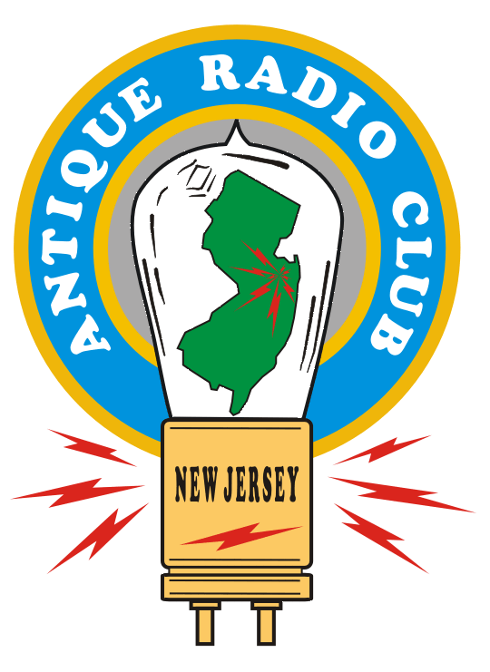
Long-Distance
AM Radio Listening
The New Jersey Antique Radio Club’s
Radio Technology Museum
At InfoAge
REV. 1.0 – 18 JAN 2018

Slide 2

The AM Broadcast Band
The birthplace of broadcasting in 1920.
Medium Wavelength - Medium Frequency
  555 Meters – 176 Meters
  540-1700 KHz
  (Wavelength = Speed of Light / Frequency)
Amplitude Modulation
  A.K.A. “Ancient Modulation”

Slide 3
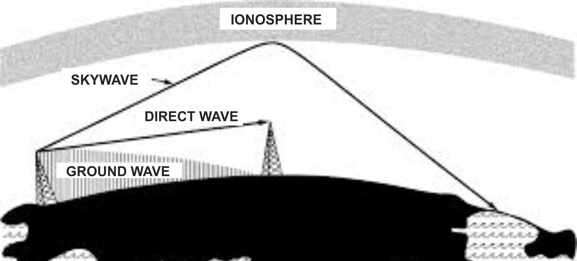
AM Broadcast Band Propagation
540 KHz -1700 Khz
Day: ground wave and direct wave, 50 miles or so.
Night: long distances via sky waves

Slide 4
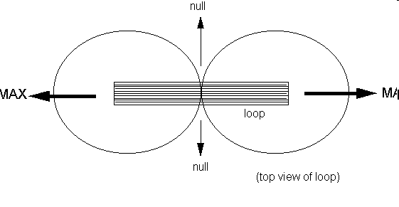
The Magnetic Loop Antenna
WSB 750 KHz
Atlanta
YVKS 750 Khz
Caracas, Ve.
MAX
MAX

Slide 5
Band Plan
4600+ AM Stations in U.S.
540-1700 KHz, 10KHz Spacing, ITU Region 2
Clear Channels: 540, 640-780, 800-900, 940, 990-1140, 1160-1220, and 1500-1580
Regional Channels: Generally 5-10KW
Local Channels “The Grave Yard” 1230, 1240, 1340, 1400, 1450 and 1490 kHz.

Slide 6
Layers of DX
Strong Locals WOR, WABC, etc.
Big-gun regionals within 500 miles:
  WBZ, Boston - 1030
  WWKB, (WKBW) Buffalo - 1520
  WWVA, Wheeling - 1170
  CHML, Hamilton, Ontario - 900
Farther
  Chicago, Atlanta, Nashville: 700 mi.
Farther still, maybe out to 2000 miles
  Iowa, Texas, New Orleans, etc.
  Caribbean, Venezuela, Mexico

Slide 7
Band Scan

