Slide 1

“Breadboarding” a
Simple FM Transmitter
The New Jersey Antique Radio Club’s
Radio Technology Museum
At InfoAge
REV. 0.1.1 – 26 JAN 2017

Slide 2
The steps of the engineering design process are to:
Define the Problem
Do Background Research
Specify Requirements
Brainstorm Solutions
Choose the Best Solution
Do Development Work
Build a Prototype
Test
Redesign
This Project

Slide 3
The Project
Assume the role of an electrical-engineering technician.
Assemble a simple frequency-modulated (FM) transmitter.
Use the solder-less breadboard technique
Troubleshoot as needed
Observe its operation

Slide 4
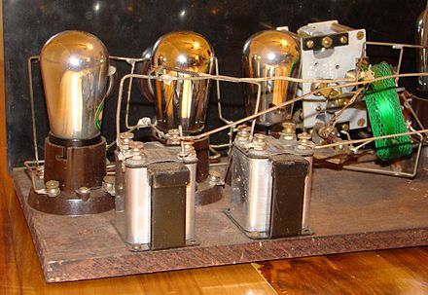
The Breadboard
From Paper to Reality
An essential step before committing to a “hard” design.
Allows easy circuit modification.
A 1920’s radio constructed
Breadboard style.

Slide 5
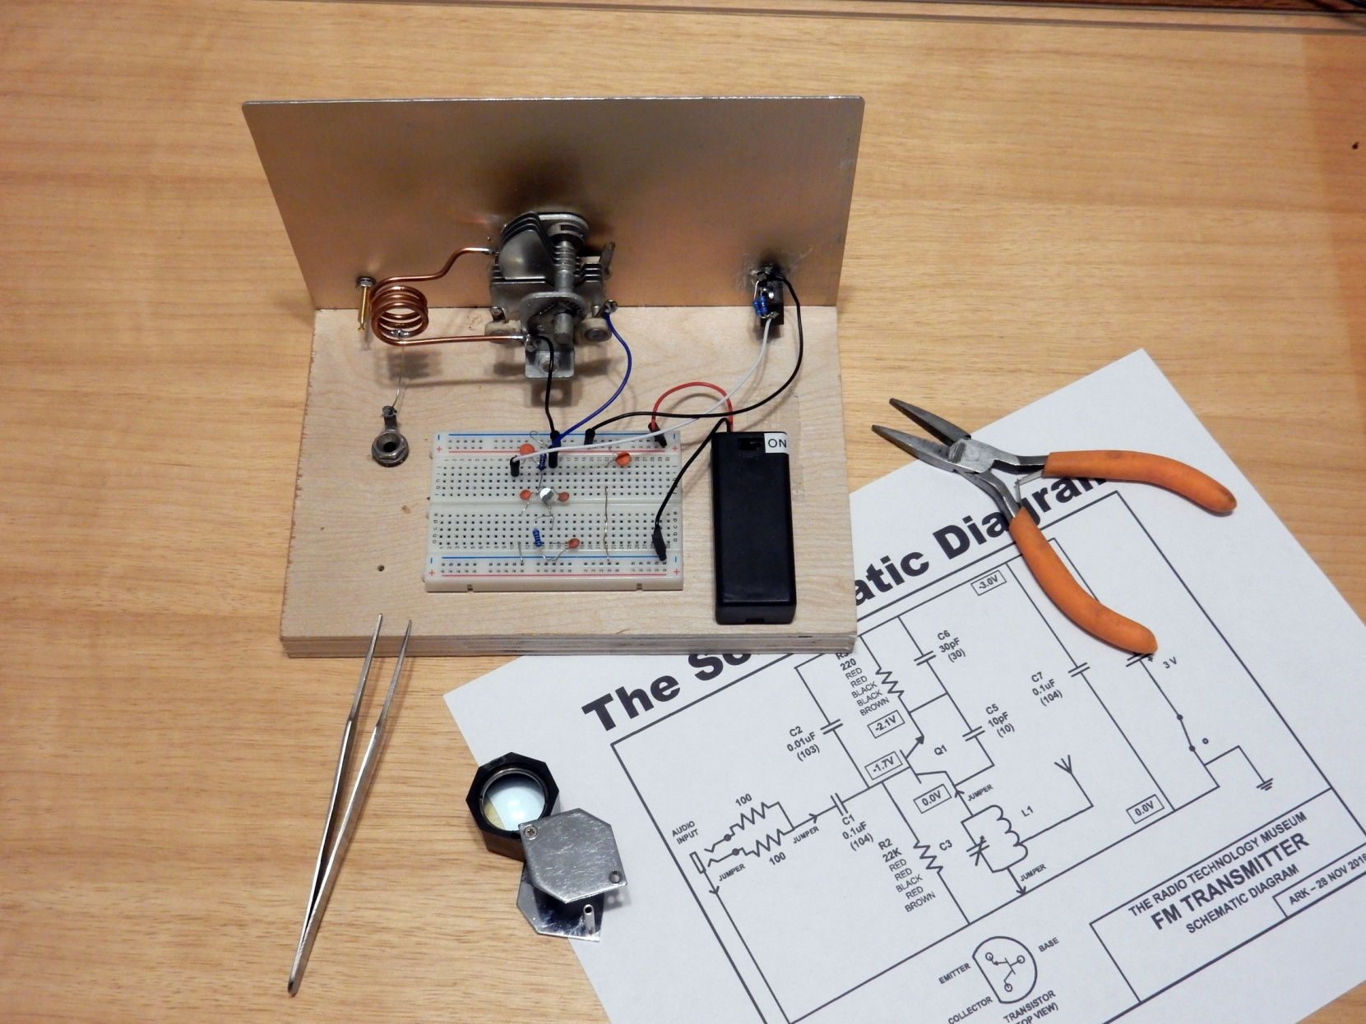

Slide 6
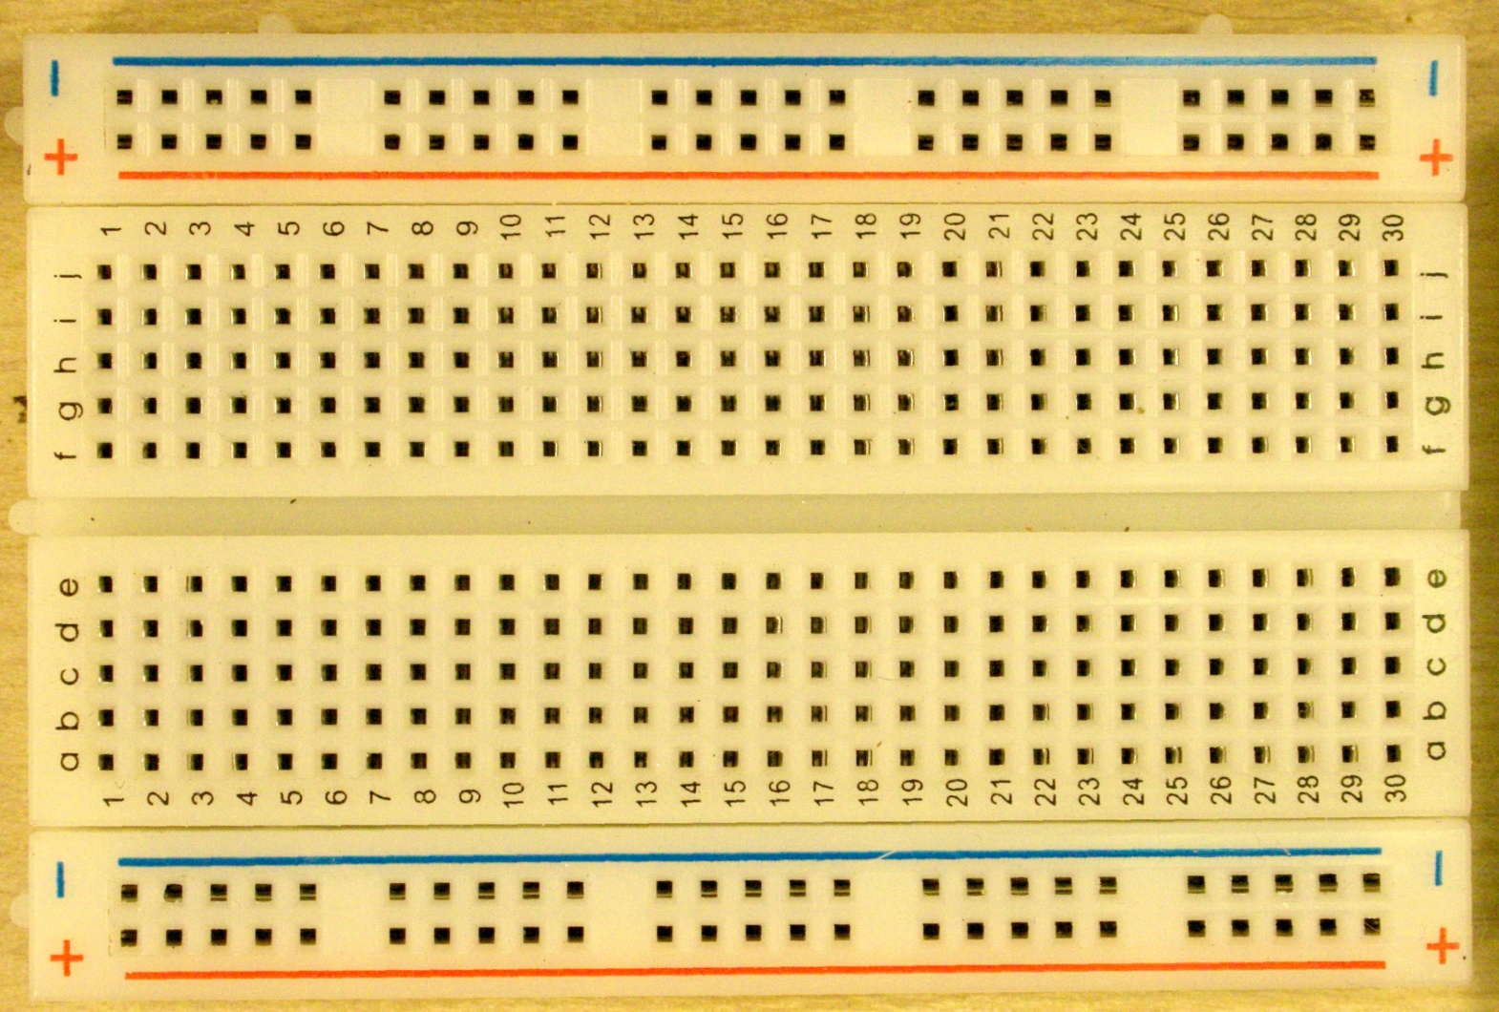
Modern Solder-less Breadboard
B+ BUS
GENERAL
WIRING
B- BUS
Shaded indicates common connections.

Slide 7

R.T.S.
Read The Schematic

Slide 8
Step 6

Slide 9
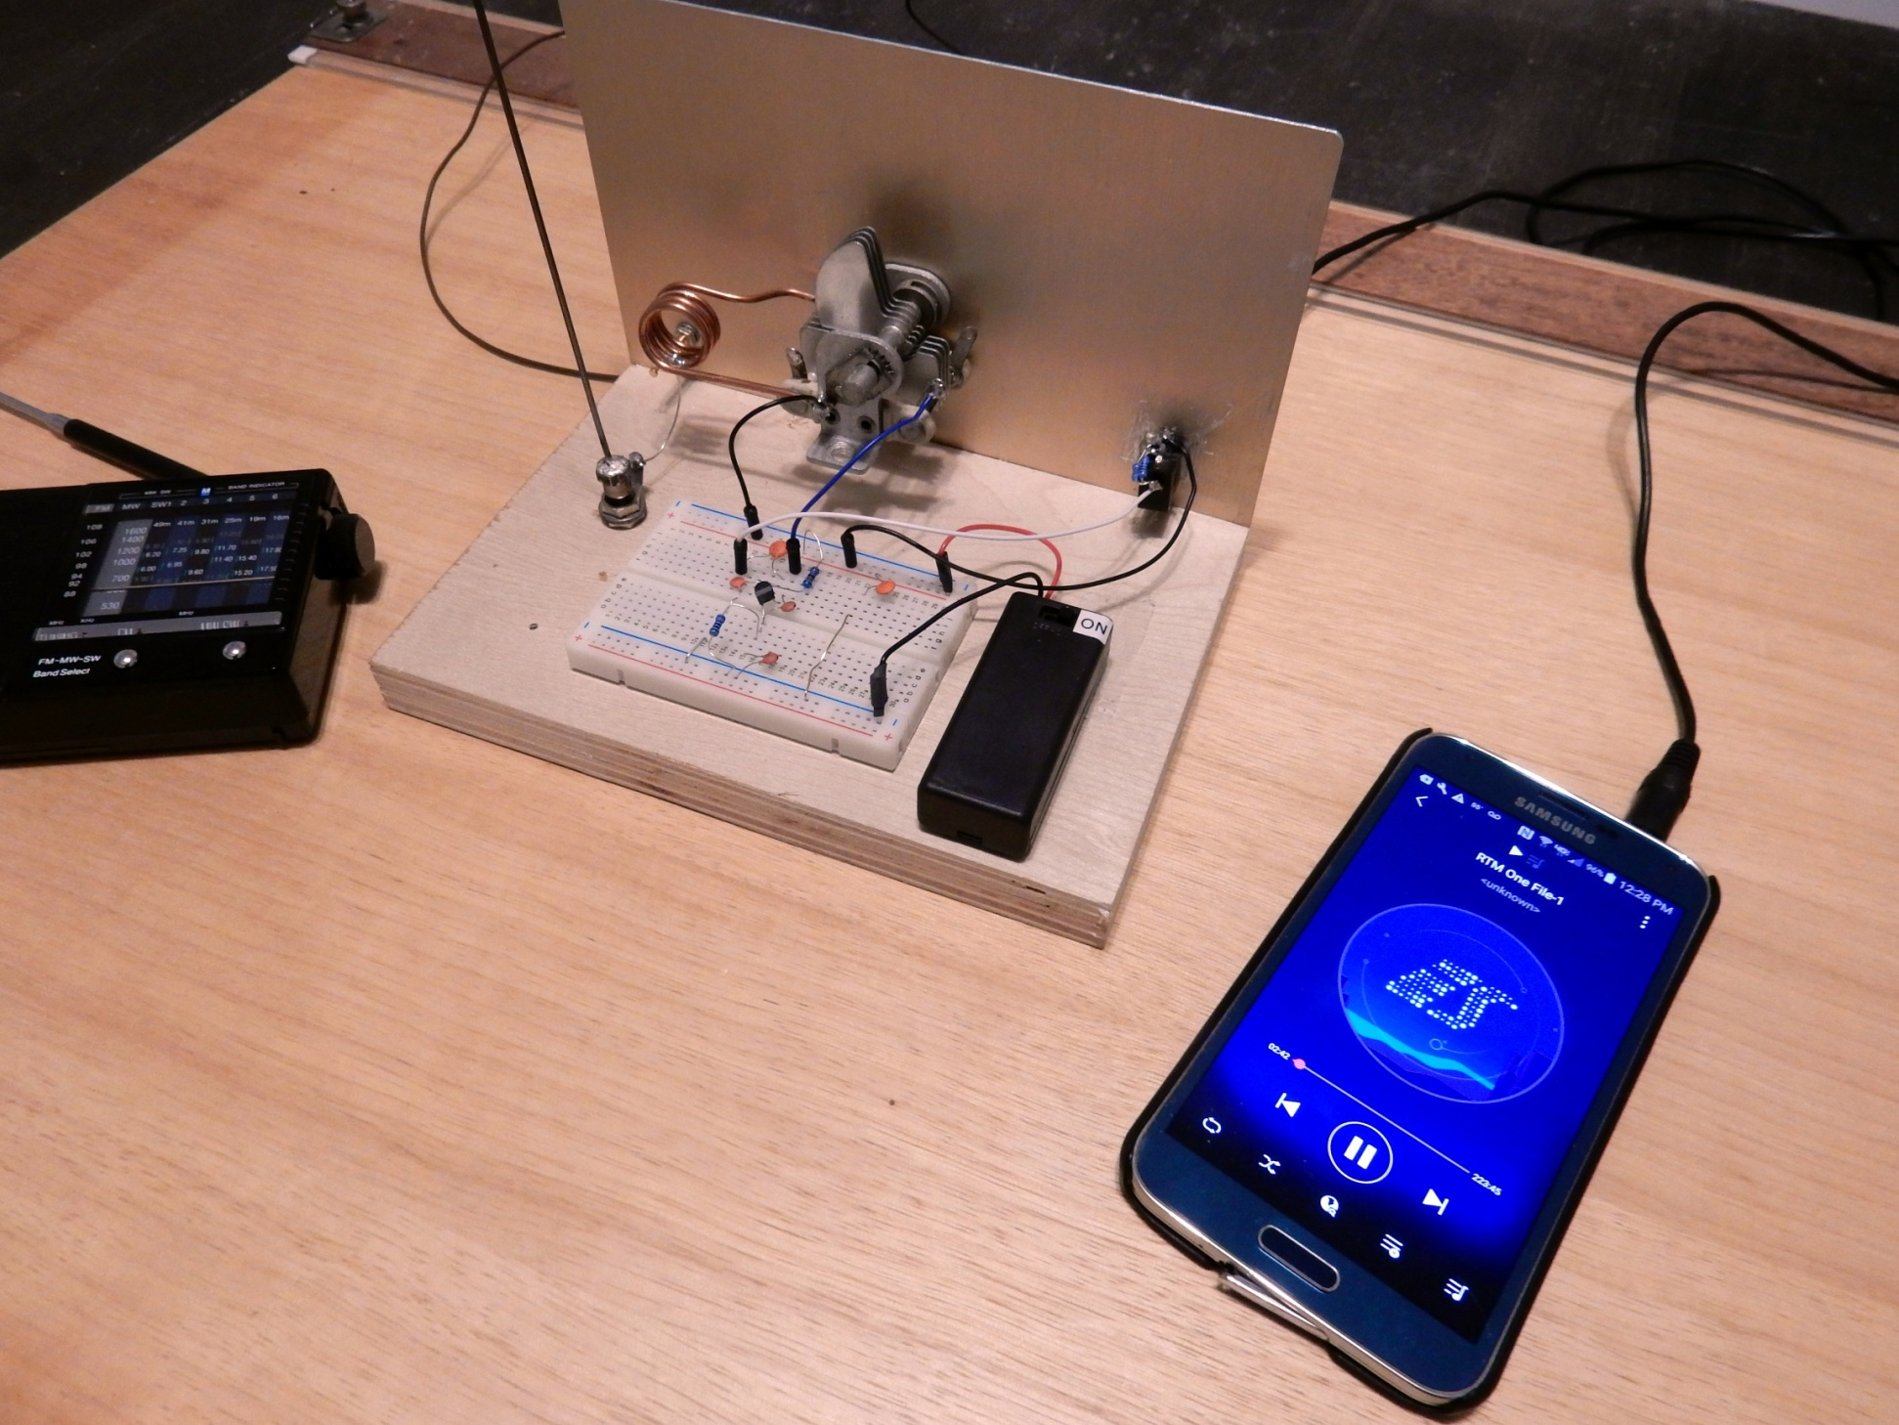
The device takes an audio input from a mobile device and broadcasts it to a standard FM radio.

