Slide 1

A Brief Introduction to
Radio Technology
The New Jersey Antique Radio Club’s
Radio Technology Museum
At InfoAge
REV. 0.1.1 – 26 JAN 2017

Slide 2
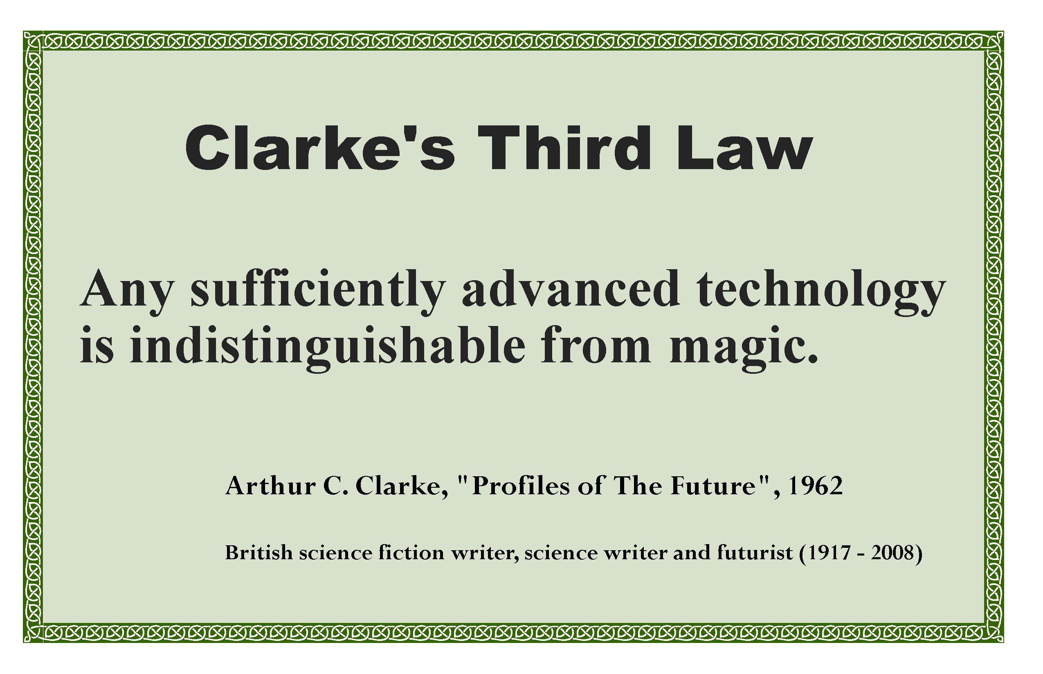
FM doesn’t always stand for Frequency Modulation!

Slide 3
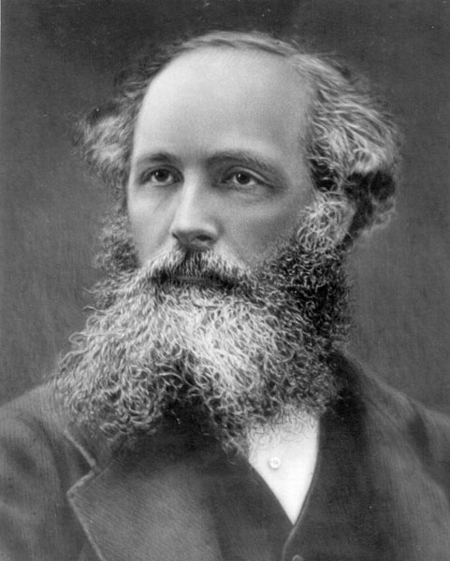
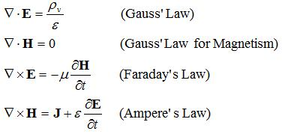
The Prediction of the Existence of Radio Waves
Maxwell’s Equations
Circa 1861
Maxwell's equations explain how electromagnetic waves can physically propagate through space.
The changing magnetic field creates a changing electric field through Faraday's law.
In turn, that electric field creates a changing magnetic field through Maxwell's addition to Ampère's law.
This perpetual cycle allows these waves, now known as electromagnetic radiation, to move through space at the velocity of light, c. (= 300,000,000 meters per second or 186,272 miles per second).
James Clerk Maxwell (1831–1879)
Scottish Physicist
I.e., Maxwell discovered the invisible world of electro-magnetic radiation with a pencil!

Slide 4
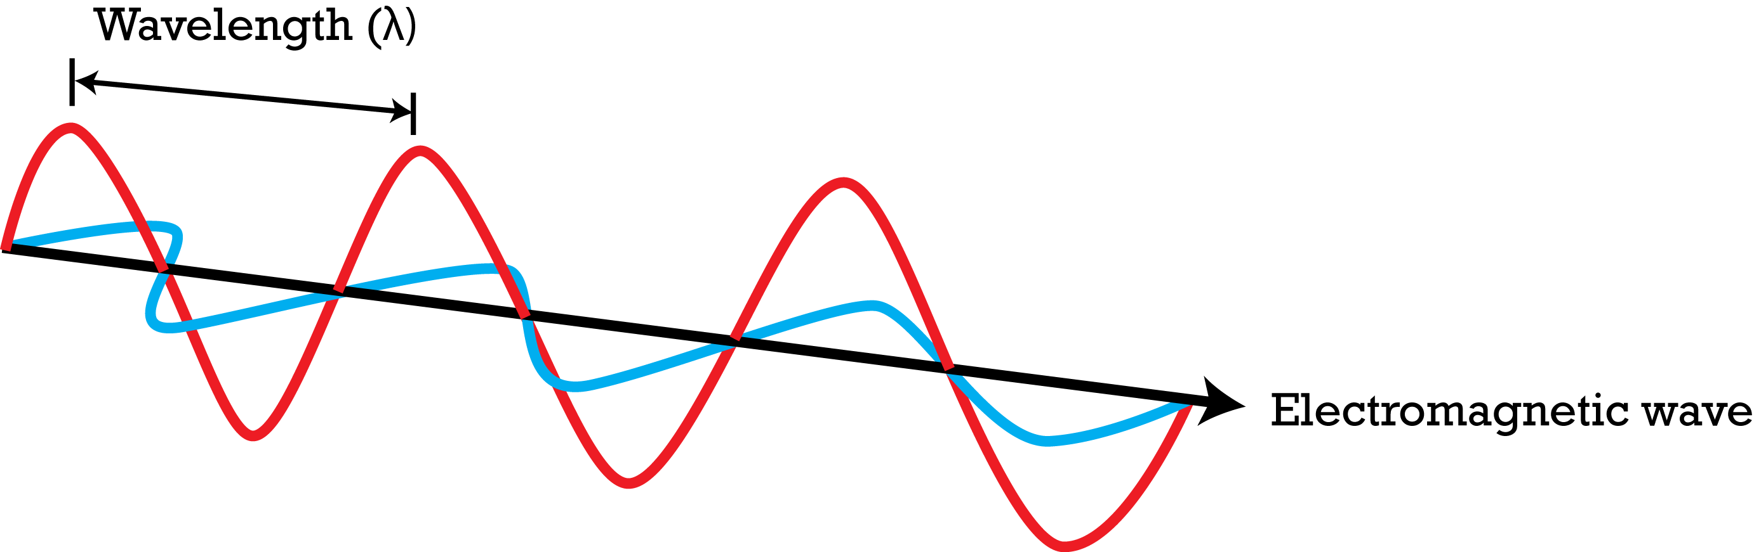
Radiant Energy
Electromagnetic Waves
Carry Energy through Space
FREQUENCY
ELECTRIC FIELD
MAGNETIC FIELD
ALTERNATING CURRENT
(IN ANTENNA)
VELOCITY OF PROPAGATION
How far does the wave travel for one cycle of the field?

Slide 5
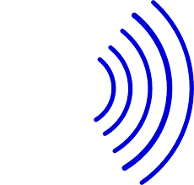


A SIMPLE RADIO SYSTEM
ELECTRO-MAGNETIC WAVES
ANTENNA
ANTENNA
MIC
SOUND
WAVES
MODULATOR
RADIO-FREQUENCY
GENERATOR
RECEIVER
INFORMATION
OUT
RADIO-FREQUENCY CURRENT
INFORMATION
IN
(SOUND)
AUDIO-FREQUENCY CURRENT
The “Carrier Wave” transports information through space!

Slide 6
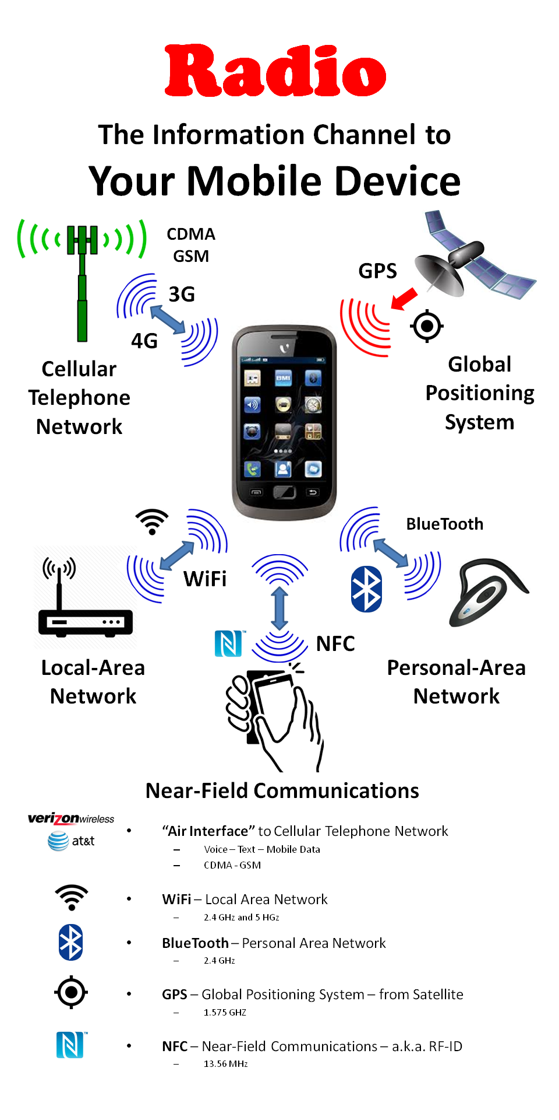
How does all that stuff get into your mobile device?
4 or 5 Radio subsystems make your device “Wireless.”
This is made possible by advances in semiconductor technology
Moore’s Law

Slide 7
Two Projects
Building a simple FM Transmitter
Long-Distance AM Radio Listening

